Slide 1




BUSINESS
PLAN
Machine Learning Term Project Proposal
Airline recommendation system
Group C
202034916 PARK SEONJUN
202234911 RHYU YEONI
202235118 JUNG SOYEON
MIRI COMPANY

Slide 2
Project
step
01
02
03
Motivation
Dataset
Filtering method
CONTENTS
04
05
06
Machine learning model
Expected Effects
Team member & role
MIRI COMPANY

Slide 3



Motivation
Flight Recommendation System
There are ongoing reports of passengers receiving unfair or unsatisfactory treatment from airlines. Since the in-flight experience strongly affects overall trip satisfaction, this project uses user ratings and service factors (e.g., seat comfort, cabin crew service) to recommend the most suitable airline or flight for each user.
# Recommend
# Based on rating
# Custom filtering

Slide 4


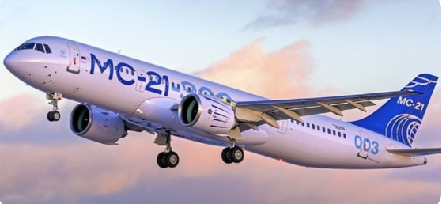

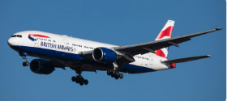
Dataset
Data set
A
B
C
Airline quality ratings
Airline Reviews
British Airline Review
120880 samples
24 columns
Gender, Age, Customer Type, Class
https://www.kaggle.com/datasets/mikhail1681/airline-quality-ratings
21900 samples
20 columns
Overall rating, Verified, Recommend
https://www.kaggle.com/datasets/juhibhojani/airline-reviews
3601 samples
20 columns
Rating, verified, recommended
https://www.kaggle.com/datasets/dharun4772/british-airline-review-dataset

Slide 5
Dataset
Data set
Test
Train
airlines_reviews.csv
airline.csv
8100 samples
17 columns
Name, Airline, Overall Rating
https://github.com/quankiquanki/skytrax-reviews-dataset/tree/master/data
41396 samples
20 columns
airline_name, author,overall_rating
https://www.kaggle.com/datasets/elijahconnectng/airlines-review-dataset

Slide 6






Filtering
Method
Overall Process
Step 1
Step 2
Step 3
Step 4
Data Preprocess
Rating matrix
Modeling
Model Evaluation
Normalize
Label encoding
Ordinal encoding
Between user and item
Cosine similarity
Content-based Filtering
SVD
MAP@K
NDCG@K

Slide 7









Filtering
Method
Content-based Filtering
Features of item
- Extract the features that consist the overall rating
Goal
User profile
- Look up the previous user rating to analyze user preferences.
Item similarity
Recommend the airline based on item similarity
- Compute item-to-item similarity using cosine similarity
Recommend
- Recommend Top-K airline and evaluate model performance

Slide 8
Filtering
Method
Model-based Filtering
Rating Matrix
- Create the rating matrix using user rating for airline
Goal
Latent factor
- Generate the latent factor from rating matrix
Predict rating
Recommend the airline based on latent factors.
- Compute dot product of user vector and airline vector
Recommend
- Recommend Top-K airlines and evaluate model performance

Slide 9
Model
Machine Learning Model
Modeling
Logistic regression(Content-Based Filtering)
SVD (Collaborative Filtering)
Preprocessing
Min-max scaling
Label encoding
Ordinal encoding

Slide 10
Expectation
Expectation
Personalized Recommendation
Consider the user’s previous preferences.
It also reflects which attributes the user cares about most.
Generalization Across Datasets
Evaluate model performance using MAP@K and NDCG@K
Future extensions
As more user-level data is collected, we can apply item-based CF and user-based CF, allowing us to generate more accurate.

Slide 11
Member Role
PARK SEONJUN: Preprocessing, Modeling and Presentation
RHYU YEONI: Modeling and Presentation
JUNG SOYEON: Modeling and Presentation

